Slide 1




Slide 2

Oral Communication
Speaking Skills

Slide 3

TEST TIME ON ORAL COMMUNICATION LISTENING
QR CODE:

Slide 4
INTRODUCTION
What is Speaking?
Speaking is the delivery of language through the mouth. To speak, we create sounds using many parts of our body, including the lungs, vocal tract, vocal chords, tongue, teeth and lips.

Slide 5

CONCEPTS
Formal versus informal speaking
Notes:
Just like in your own language, the way you speak depends on who you are speaking to or with. Informal speaking situations include speaking with close friends, family workers and probably co-workers. Slang, idiom and relaxed pronunciation are more common in these situations. Small talk becomes less necessary when you are speaking with friends, but is considered polite in an informal situation with acquaintances. Sometimes your pace and volume shifts when you feel more comfortable. Formal situations require a different kind of language. Your speaking may even be rehearsed in some situations. You may feel nervous about saying everything properly. You must also consider manners and body language.

Slide 6
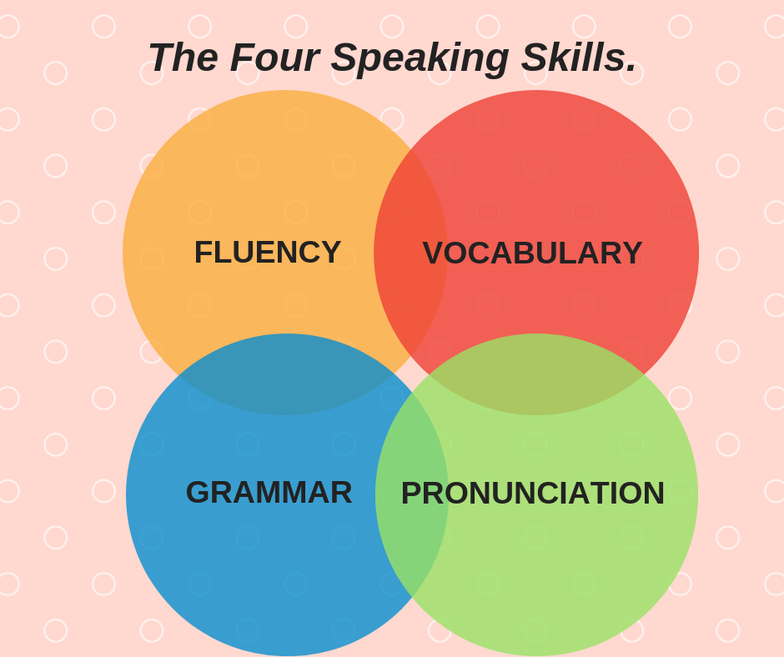
CONCEPTS
Speaking tips

Slide 7
CONCEPTS
Listen first. Try not to think about what you are going to say as you’re listening. Focus on listening, then focus on responding.
Make eye contact. It’s important to make eye contact when you’re listening and speaking. Even if you’re nervous, try not to look at the ground. If you’re doing a presentation, practise enough so that you don’t have to read every word from your notes. Visuals can help you in a presentation.
Learn transitional phrases and useful expressions. You will keep your listeners’ attention if you know some key expressions that will make the conversation flow.

Slide 8
CONCEPTS
Use gestures appropriately. If you’re in a foreign country, take time to learn about body language. Some gestures in your country may mean something different in another country.
Relax. You don’t have to speak perfectly. Many native English speakers are also nervous when they have to speak out loud in a group or with people that they don’t know. Try not to show that you are nervous.
Don’t say sorry. If you apologize for your English, people will expect it to be poor. Believe that you are a strong English speaker, and your listeners will believe it too. If you make a mistake, simply keep talking or correct yourself.

Slide 9
CONCEPTS
Be yourself. Let your personality out! People will enjoy speaking with you because of who you are, not because of the language you speak.
Keep it simple. As with writing it is important to speak in the simplest way you can. Don’t try to impress people with your large vocabulary. Use words and expressions that you are confident using.
Pause and pace. Try not to speak too quickly, which may make it difficult for people to understand you. Listen to English speakers often to hear where natural pauses occur.

Slide 10
CONCEPTS
Practise pronunciation, including word stress. One of the most important aspects of understanding each other’s spoken English is through the natural rhythm of our words and sentences. Native English speakers don’t think about word stress. They just speak. People who learn English as an additional language need to listen to English often in order to be able to use natural word stress.

Slide 11

CONCEPTS
The 3 P’s of Successful Public Speaking
Notes:
Are you one of the many people who is terrified of public speaking or are you one of the few who knows the benefits of it?
Public speaking is said to be one of the most feared activities in life. According to Wikipedia, 75% of the population experiences anxiety or nervousness when speaking in public. So, if giving a speech or lecture makes you break out in a cold sweat, you are clearly not alone.
“According to most studies, people’s number one fear is public speaking. Number two is death. Death is number two. Does that sound right? This means to the average person, if you go to a funeral, you’re better off in the casket than delivering the eulogy.”
~Jerry Seinfeld
Personally, I love public speaking. I know this makes me strange in the eyes of many, but please don’t hold it against me. I started speaking publicly when I was very young–probably too young to know I was not supposed to enjoy it. I remember giving my first public talk in Sunday School when I was in first grade. My father helped me prepare and make notes in 3 x 5 cards. And he sat in the back of the room to “cheer me on.” And I was hooked.
Public speaking doesn’t have to be a nerve-wracking experience. In fact, speaking and presenting can help you build your business. But before you can become a successful public speaker you need to overcome your fear by following these three simple steps: Prepare, Practice and Present.

Slide 12
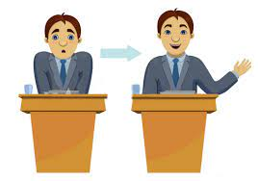
CONCEPTS
Prepare
Notes:
When you agree to speak, start by doing your homework. How large will your audience be? How long are you to speak? What type of presentation is expected? The more you know, the easier it will be to prepare.
Write and create your presentation well in advance. Waiting until the last minute won’t make it easier and will create additional stress. Preparing well ahead of time will not only give you more time for the next step, practice, it will also help relieve your anxiety.
And keep those presentations you’ve prepared on file. Should you ever be presented with a last-minute opportunity, you’ll already have something prepared, and won’t be so stressed.
Stop thinking about yourself and focus on your audience. As you prepare, consider: What does my audience need? Why are they here? How can I help them? Focusing on your goals and their needs will help shift your perspective.

Slide 13

CONCEPTS
Practice
Notes:
Practice, practice, practice. Know your presentation upside down, inside out and backwards. Don’t memorize your speech—and don’t read from a script. Once you know it well, you can use an outline with your key points highlighted to help you stay on track. Here are some additional public speaking practice tips from Toastmasters International.
If you are using a slide presentation, don’t read it. Make your visual aids just that—aids. Use them to provide engaging illustrations and brief highlights, and then talk about your subject with your audience.
Arrive early. Running late and being rushed only increases stress and anxiety. Arriving early gives you a chance to see where you’ll be speaking, get comfortable with the space, meet and talk to a few people, and find a quiet spot to take a few deep breaths and calm yourself before you start. If you’re going to be using visual aids, like videos or slides, make arrangements to test your equipment before the room is full.
Arriving early can also give you time for a last-minute read through which may help boost your confidence and calm your nerves.

Slide 14

CONCEPTS
Present
Notes:
It’s show time. You’ve prepared well and practiced until you know your presentation better than you know the alphabet. Just a few more tips to help you nail this one.
First, all those people in the audience—well, most of them—are just happy it’s you up there and not them. They came to see you succeed. They’re on your side and they’re rooting for you—so relax and roll with it.
Next, don’t make too much of audience expressions. People make weird faces—don’t interpret them as anything more than that. Accept that sometimes your audience will look funny and move on. Snoring may be a different story, however. . .
Finally, engage your audience—don’t talk at them, talk with them. Ask for questions and answer them. More interesting, less boring. You’re not performing, you’re conversing. Are you nervous when you’re conversing with your friends? This should feel the same way. It may not the first few times, but with practice it usually gets easier and less uncomfortable.
Keep your focus on your purpose and your audience. The more you think about them, the less time you have to think about yourself and how much you don’t want to do this. By the way, a few butterflies are good. But just a few–They are there to remind you that this is important to you.
By putting these three P’s into practice, you can overcome your fear of public speaking and become a successful public speaker.

Slide 15

CONCEPTS
Grab Attention

Slide 16

CONCEPTS
Start with the unexpected
Notes:
Start with a bang, not a whimper. Smokers like matches that light with the first strike, and listeners like presentations that ignite interest with the first sentence. For instance:
"We stand today at a place of battle, one that 40 years ago saw and felt the worst of war."--President Ronald Reagan
"I stand before you today, the representative of a family in grief, in a country in mourning, before a world in shock."--The Earl Spencer, brother of Lady Diana.
"I wish you could have been there…"--Patricia Fripp, CSP, Former President of the National Speakers Association.
Each of these opening lines makes us lean in, lend an ear, and wonder where the speaker will take us. They jump right into the subject and create suspense, intrigue, curiosity. They capture neck-down attention.

Slide 17

CONCEPTS
Make it about them
Notes:
Now that you've gotten listeners' attention with your magnetic opening, make the story about them. Increase your You-to-Me-Ratio. Talk about their goals, their aspirations, their anxieties. Cicero, a Roman statesman and orator, and one of the greatest speakers in the history of the world, said, "Tickling and soothing anxieties is the test of a speaker's impact and technique." He meant that you can capture attention if you remind an audience of a felt need, a pain point, or a threat to their well-being.
"Ring around the collar," was a 1968 ad in which a housewife protected her husband from loss of social status and career disaster by using Whisk on his shirts. And many consultants I know use something called FUD to sell their projects: Fear, Uncertainty, and Doubt. A smattering of FUD gets our attention. When I feel it, I feel it in my chest.

Slide 18

CONCEPTS
Keep it concrete at the start
Notes:
Show a prop. Use language that appeals to the senses. Don't tax the audience right away with abstract reasoning or academic concepts. Better to hide your smarts than to wear them on your sleeve. Storytelling is a powerful way to get into a topic because we are hard-wired to absorb information through storytelling. Tell a good story and you'll get neck-down attention.
I once heard Robert Kennedy, Jr. speak about conservation on a boat on the Hudson River. He began by pointing south. "If you look in that direction," he said, "You will see the channel that for millions of years has been the largest spawning ground for sturgeon in the world."
Of course, when I looked where he was pointing, I saw nothing but gray polluted water, not a sturgeon in sight, but I had the image of millions of large fish teeming so densely on the surface of the river that I could have walked across their backs to New Jersey.
Only then did he dive into the data about the poor, languishing Hudson.

Slide 19

CONCEPTS
Keep it moving
Notes:
Not just in terms of pace, but in terms of development. Make sure that every new bit of information you provide builds on what came before. We lose interest in movies when nothing is happening, or novels that stop while the author describes a bucolic setting for two pages. Our brains are saying, "I want action! Drama. Suspense." The same holds true for your listeners. They are time-pressed, content-driven, and results oriented.
Think of the difference between a river and a canal. A canal is plodding while a river is dynamic and constantly changing. To please your listeners' insatiable desire for variety, make your presentations like rivers, not canals. Make sure there's always something happening, most especially when delivering webinars, where your audience is likely to be highly distracted.

Slide 20

CONCEPTS
Get to the point
Notes:
One of the great pleasures the audience has is quickly grasping what you're getting at. They resent you when you rob them of this pleasure.
I once saw an ad for a Seth Godin speech on why marketing technical products was too important to leave to marketing. When I saw the video, the first words out of his mouth were, "Marketing technical products is too important to leave to marketing." It was a no-nonsense speech that moved like a bullet train, straight down the track of that single point. Give them only one point, make it early and often, and they'll carry you out on their shoulders.

Slide 21

CONCEPTS
Arouse Emotion
Notes:
Humor is inherently persuasive. It gives the speaker an unfair advantage because it literally changes the chemistry in the room, and in the brain of everyone present. But don't try to tell jokes if you're not a comedian. Simply allow your natural sense of humor to be present in the moment, and when something comes to mind, allow your humor to reveal itself.
Confessing something personal about yourself can also make the audience feel connected with you. I had a client recently--a senior person in her company--who confessed to her colleagues at a major company meeting that she had been a bar tender, a taxi driver, and short-order cook in order to pay her college tuition. The audience was amazed and thrilled as she drove home her point that we can all do more than we realize if we have the will to do whatever it takes. One definition of courage, she said, is acting out of character.

Slide 22

CONCEPTS
Keep it interactive
Notes:
Social scientists have demonstrated that an interactive audience is more easily persuaded than a passive one. In many circumstances, the give and take between speaker and audience breaks through the reticence and reserve of listeners, encouraging them to engage with the speaker and play a part in the proceedings.

Slide 23

CONCEPTS
Write clear headlines
Notes:
Write headlines for your slides that express a point of view. The audience will get the big idea and look at the body of the slide for evidence that supports your point.
For instance, "We Can Dominate the Market" is a better headline than, "Market Share." It's better because it implies action, it's brimming with intellectual and emotional content, and it captures the physicality of neck-down attention much more than the inert phrase "Market Share."

Slide 24
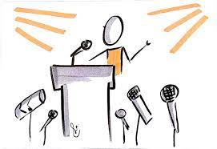
CONCEPTS
Keep it short
Notes:
Stop talking before they stop listening. The mind cannot absorb what the behind cannot endure.

Slide 25
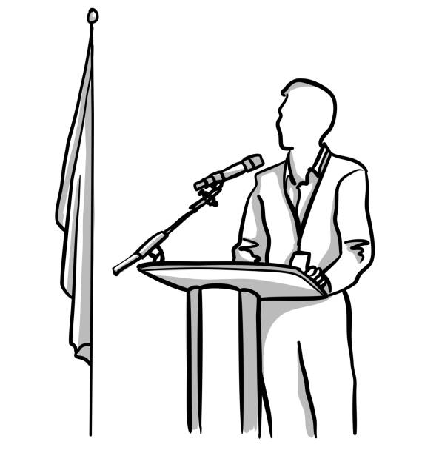
CONCEPTS
Let there be you
Notes:
The presence of a human being alone on a stage of any kind, whether it's the floor of a small meeting room or the elevated platform of a vast ballroom, is profound. It immediately creates neck-down attention. Ralph Waldo Emerson said, "What you are speaks so loudly that [nobody] can hear what you're saying."
Listeners interpret everything a speaker does: they read your face, your inner rhythm, your posture, voice, and stance. In fact, the human mind ascribes moral intention to physical cues having the slightest hint of emotional expression.
The problem is the mind does this in a matter of seconds, and you have to speak longer than that. Plus you may be nervous, not at your scintillating best, so your technical skill at capturing and holding attention could be the difference between success and failure.
Every business presentation will have plenty of moments when the audience will have to work hard and pay attention to grasp the material. I am suggesting that your results, and your reputation, will improve when your audience finds you and your content fascinating.

Slide 26

https://learn.codemithra.com

Slide 27




THANK YOU
+91 78150 95095
codemithra@ethnus.com
www.codemithra.com

